Slide 1
Resource Modeling
with REST
Tips for Building a Better REST API
DeAndré Carroll
Sr. Software Engineer, Splunk

Slide 2
REST Refresher

Slide 3
What is REST?
Representational State Transfer
Defined by T. Roy Fielding in 2000 for his PhD dissertation.
Resource oriented architectural style reflected in the structure of the world wide web.
Usually implemented in HTTP but does not have to be.

Slide 4
Properties of REST?
Client-Server
Stateless (Communication)
Cache
Uniform Interface
Layered System
Code-On-Demand

Slide 5
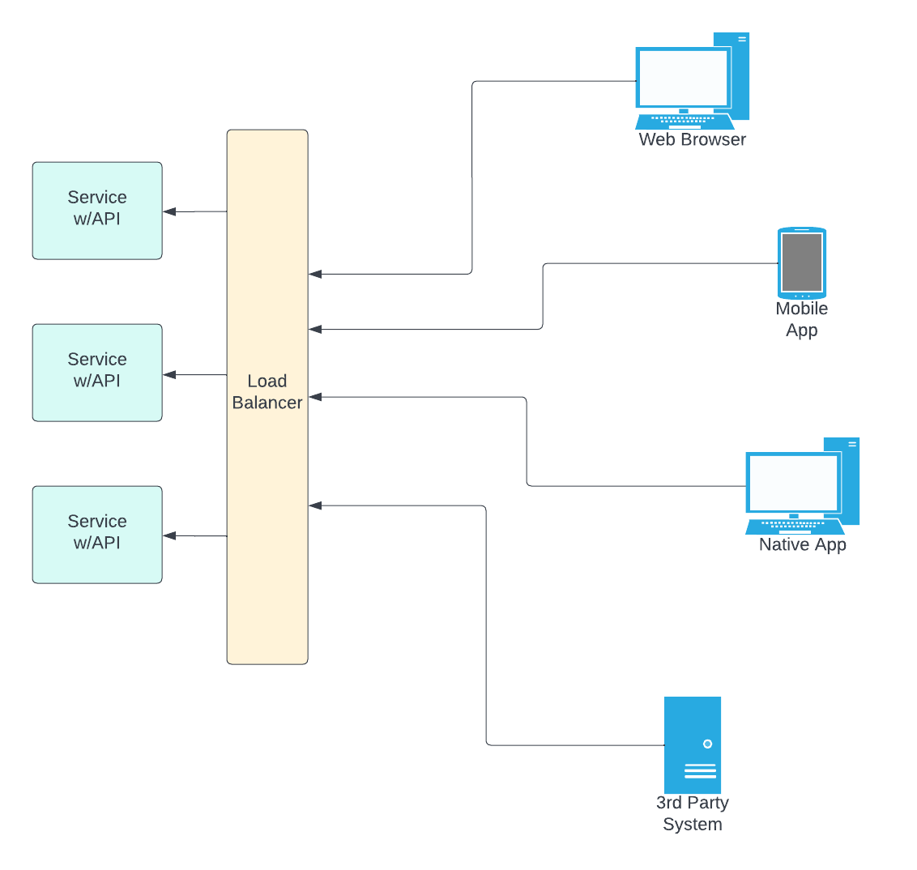
Client-Server
Separating the user interface concerns from the data storage concerns
Improves portability of the user interface
Improves scalability by simplifying the server components.
Separation allows the components to evolve independently

Slide 6
Stateless (Communication)
Induces the properties of:
Visibility
Reliability
Scalability

Slide 7
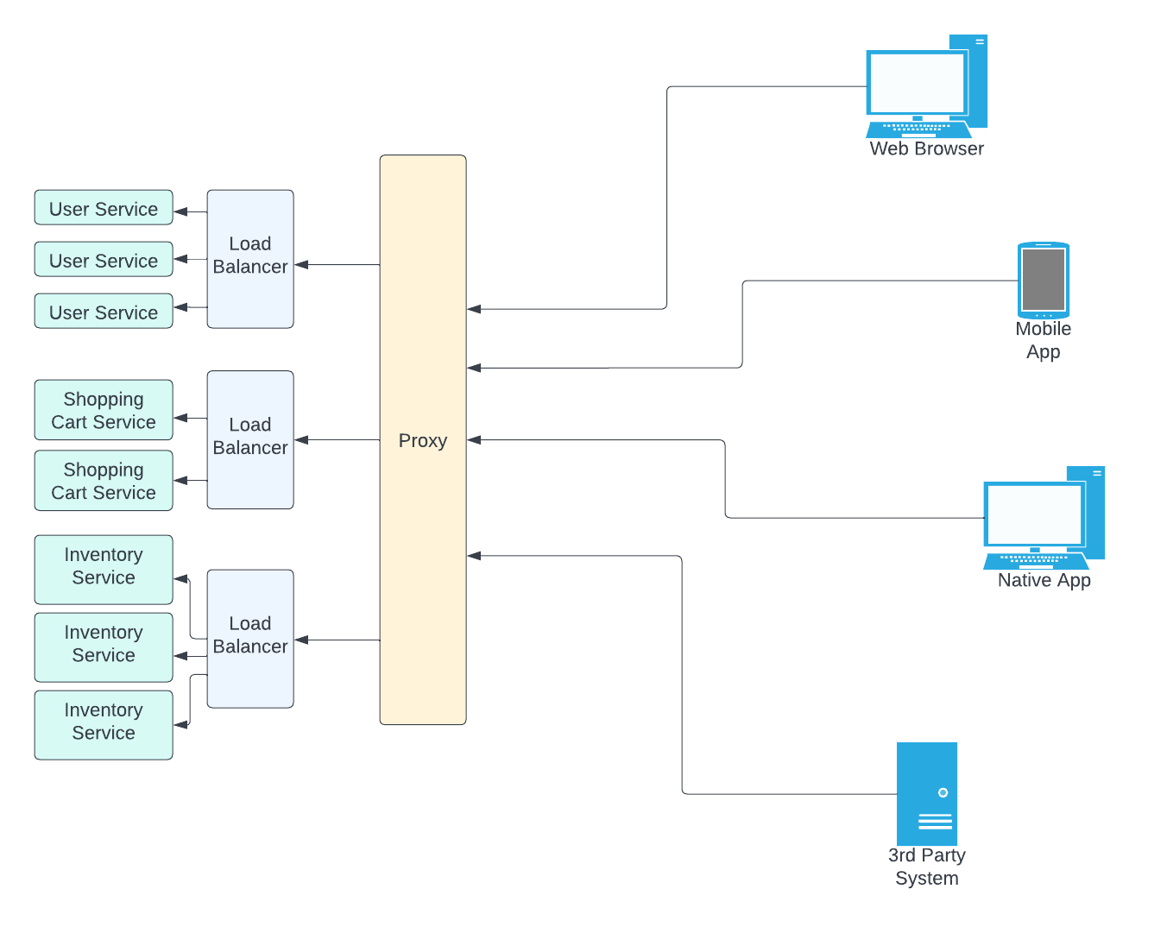
Stateless (Communication): Visibility
Visibility is “the ability of a component to monitor or mediate the interaction between two other components.”
“Visible” because each component of the system can “see” details of the request and resource.
Allows additional components (e.g. proxies, caches, etc.) to be added to the system because it isn’t necessary to examine several requests to determine the context of the current request.

Slide 8
Stateless (Communication): Reliability
Reliability is improved because it eases the task of recovering from partial failures
Any failure on the network and server can recover in deterministic way
If the problem happens on the server, it can be compensated using last state on the client
If the problem happens on the client, it can be compensated by using the state on the server

Slide 9
Stateless (Communication): Scalability
Scalability is improved by allowing the addition of more servers that don’t have to “know” client application state.
Application (session) state is therefore kept entirely on the client (No cookies)

Slide 10
Stateless (Communication): Concerns
May decrease network performance by increasing the repetitive data (per-interaction overhead) sent in a series of requests (removes shared context)
Reduces the server's control over consistent application behavior, since the application becomes dependent on the correct implementation of semantics across multiple client versions.

Slide 11
Cache
Used to improve network performance
Can be cached on client side or server side
Data within a response to a request is implicitly or explicitly labeled as cacheable or non-cacheable
Caching can decrease reliability if stale data within the cache differs significantly from server data

Slide 12
Uniform Interface
REST is defined by four interface constraints:
Identification of resources; * self-descriptive messages
Hypermedia as the engine of application state
Implementations are decoupled from the services they provide, which encourages independent evolvability
The trade-off, though, is that a uniform interface degrades efficiency, since information is transferred in a standardized form rather than one which is specific to an application's needs
Manipulation of resources through representations

Slide 13
Layered System
Allows an architecture to be composed of hierarchical layers by constraining component behavior such that each component cannot "see" beyond the immediate layer with which they are interacting
Code-On-Demand
Allows client functionality to be extended by downloading and executing code in the form of applets or scripts
Reduces visibility, and thus is only an optional constraint within REST.

Slide 14
Good REST API Design

Slide 15
Start with your API
API design should not dictate your architecture, but it may likely inform it
If you are working with an existing system, establish your API as a “facade”
Think about the capabilities that need to be exposed to your client

Slide 16
“It’s all the same. Only the names will change.” -Jon Bon Jovi

Slide 17
Computational System Design Models
Microcomputer architecture
Unix operating system

Slide 18
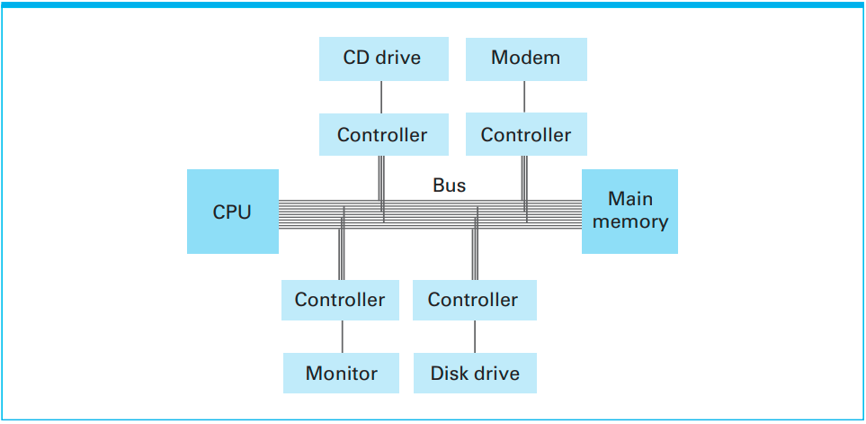
Computational System Design Models
Microcomputer architecture
The core processing unit (CPU/ALU) accesses all resources through an address bus.
Memory
Controllers

Slide 19
Computational System Design Models
Unix operating system
Everything is a file
Directories (/home/user)
Devices (/dev)
Links (made with ‘ln’ command)
Sockets and named pipes (special files for passing information)

Slide 20
REST Design Tips
Model your process not the implementation
Design resources and representations that reflect your business logic
Design resources as nouns (not verbs or prepositions)
Design resources and representations to be composable

Slide 21
Model your process not the implementation
Critical processes (i.e. resource ID assignment) should be isolated to the server
Errors should reflect business logic problems (only implementation/system problems when absolutely necessary)

Slide 22
Design resources and representations that reflect your business logic
Keep in mind
Creation and change properties
Atomic transaction/immediate consistency vs eventual consistency
Synchronous vs asynchronous
Network efficiency
Size of representations
Client convenience to guide resource granularity

Slide 23
Design resources and representations that reflect your business logic
Avoid modeling
Your persistence schema
Other traits of your implementation

Slide 24
Design resources as nouns (not verbs or prepositions)
Resources can be designed in ways similar to objects in OOP (not necessarily nouns in the strict sense)

Slide 25
Know your verbs, their design, and their capabilities (the Uniform Interface)
POST
GET
PUT
PATCH
DELETE

Slide 26
Use POST
To create a new resource, using the resource as a factory
To submit input to any process that would be asynchronous
To run queries with large inputs
To perform any unsafe or non-idempotent operation when no other HTTP method seems appropriate
Basically, anything POSTed to a resource becomes a subordinate of that resource

Slide 27
Use POST
To create a new resource, using the resource as a factory
System specific values (i.e. unique IDs) should be generated by the resource server to prevent business logic from implemented in the client

Slide 28
Use POST
To submit input to any process that would be asynchronous
Commands
CRUD for resources that are eventually consistent
Use a batch processing model
POST to a resource that creates a progress resource
The progress resource shows the completion state of the request
Upon completion, a request against the progress resource redirects to a completed resource
As an alternative, asynchronous notification can be issued via a configured webhook or websocket

Slide 29
Use POST
To run queries with large inputs
Safer than using query variables in a URI
Used to be used as a server attack method, inducing a buffer overflow

Slide 30
Use POST
To perform any unsafe or non-idempotent operation when no other HTTP method seems appropriate
Processes that yield side effects are executed this way

Slide 31
Using GET
For safe and idempotent (no side effects) information retrieval of resources
To fetch a representation containing the output of the processing function or data over a continuous domain
Map data, mathematical functions, etc
Use query parameters to supply inputs

Slide 32
Using PUT
To update named individual resources in an idempotent (no side effects) way
Best for resources that already exist on the server
Process should be atomic (immediately consistent)

Slide 33
Using PATCH
To update resources in an idempotent, non-constrained way
Do NOT use
If the underlying operation is not atomic/non transactional
If the input is constrained to a well-defined, unchanging representation
Use PUT instead

Slide 34
Using DELETE
To remove individual resources from visibility
Can be removed from the system
Can be archived
May be implemented asynchronously

Slide 35
Let’s Build an API
We’re building a system that keeps track of users and their mailing addresses. The user information consists of…
First name
Last name
Email address
Phone
Mailing address
Street 1
Street 2
State/Province
Postal code
Country
Part 1:
Implement CRUD (Create, Retrieve, Update, Delete) for the data resource as represented here.
What does the URI look like for a collection? An individual resource?
What does the representation look like?

Slide 36
Let’s Build an API
We’re building a system that keeps track of users and their mailing addresses. The user information consists of…
First name
Last name
Email address
Phone
Mailing address
Street 1
Street 2
State/Province
Postal code
Country
Part 2:
Implement CRUD (Create, Retrieve, Update, Delete) for two data resources, one for the user and one for mail.
How are the two linked?

Slide 37
Design resources and representations to be composable
Resource representations can be composed into a larger resource for easier access
This should be driven by monitoring client usage patterns
Remember the user/mail example

